Slide 1
Mentorship: what works/ lessons learnt
Winnie N. Shena
LARC In-Country Faculty

Slide 2

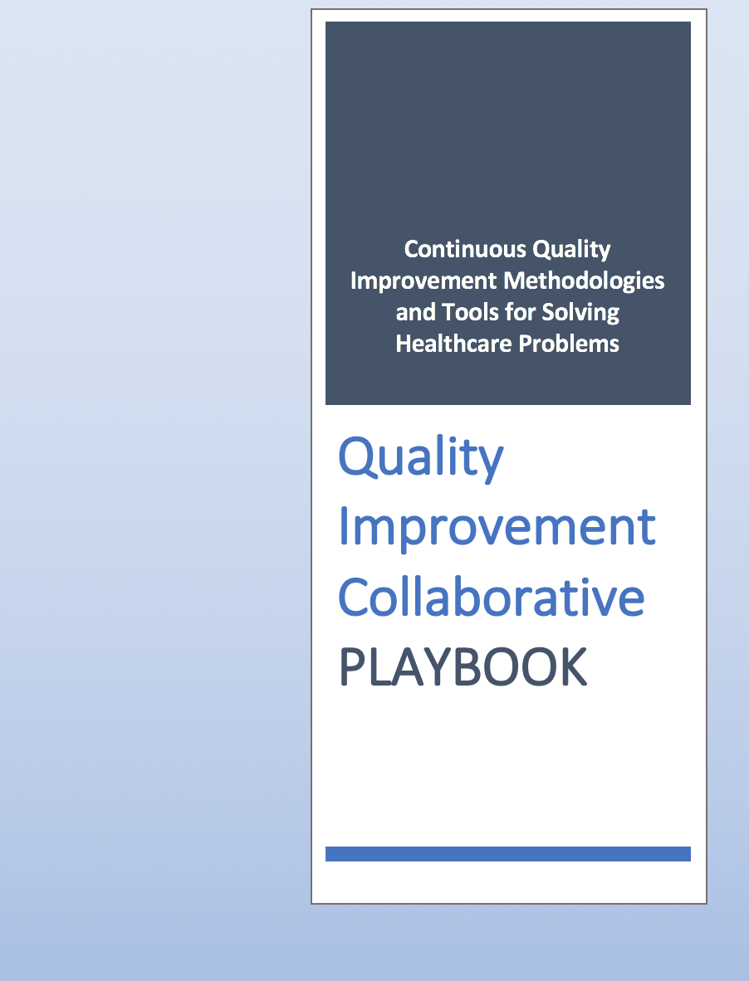
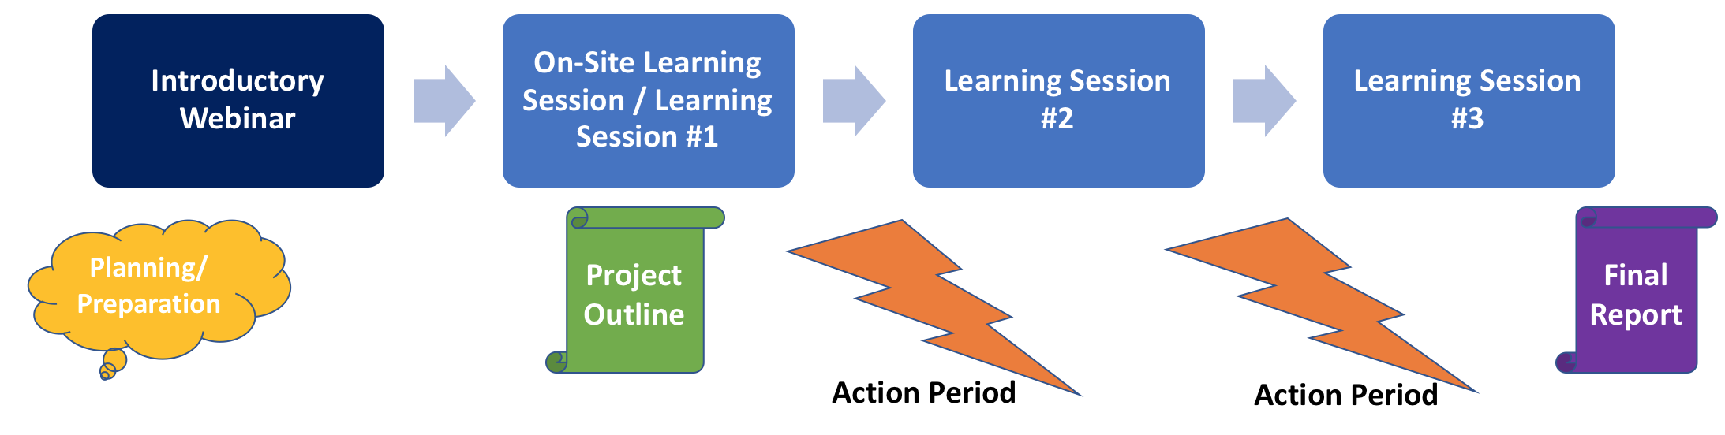
What is LARC?
Laboratory African Regional Improvement Collaborative
Bringing together multidisciplinary clinical teams to improve any process or system
CURRICULUM: Quality Improvement (QI) Methodologies |  | DELIVERY MODEL: Learning Collaborative |  | OUTCOME
 |  |  |  | IMPROVEMENT Better, Safer, Higher Quality, Client-Centered Healthcare Delivery
Focused on QI concepts, skills, tools & implementation 30+ QI Tools with Templates Coordinated step-by-step guidance through project Just-in-time training to produce QI project deliverables |  | Introductory Webinar 4 Learning Sessions – 1 On-Site Delivered over 6-9 months Action Periods Interspersed for Project Implementation Mentoring & Coaching Site Visits Learning shared among collaborative members |  | Successfully Completed Project/s Embedded QI Concepts & Skills → Culture of Improvement

Slide 3


LARC-
Successful project is not one that receives a trophy!!!
LARC- has a prescribed/ charted path…
Curriculum…
deliverables…
Aim statement…….
LARC- could be perceived to be Tedious, Complex, Confusing Unending demands Slow…

Slide 4

Quality Ninja
LARC program does not expect you to become a Quality Ninja Over Night.. However.. Step by step, tool by tool, metric by metric teams will master skills and competencies in LARC ….

Slide 5


Mentorship and coaching In LARC is available to ensure teams are able to implement their project while catalyzing learning. It ensures that we take the journey together with teams..

Slide 6
WHAT WORKS
Involve all key stakeholders:
  Identify key stakeholders and engage them at the earliest opportunity.
  Clarify the role of each stakeholder
  Develop a regular, effective and clear communication pathway.

Slide 7
WHAT WORKS
Team approach:
  Clarity on team roles must be clearly sought out at the onset
  Teams must be able to hold each other to account (if one team member is not pulling their burden create an environment to discuss how this affects the team and its progress)
  Open and honest communication across teams..
  Prioritize team meetings to discuss progress.
  If team members are not adequate – expand the team membership.

Slide 8
WHAT WORKS
  Conduct follow up at the earliest opportunity to:
  Avoid – the Kilimanjaro syndrome ,strengthen information and skills set while the knowledge is still fresh
  Identify potential barriers that would impede the project progress.
  Clarify the expectation of the team on the project and the expectation of the project on the team.

Slide 9
WHAT WORKS
Make the project practical : walk, See and do.
  Do more than just hear, or receive testimonies walk through the project location interact with the members of the project to include the customers.
  Do more than just checking data and ticking a list be a coach and mentor to achieve competencies.
  Listen to understand and not to respond.

Slide 10
Lessons learnt
LARC is hard work-
Teams should understand that time is never sufficient but must be created.
For teams to achieve all key members must be involved.
  Take time to wait on the slow members to catch up – move as a team
Commitment is a conscious choice that must be taken, it may entail sacrificing off time or lunch breaks.
As a supervisor give meaningful feedback to the team.

Slide 11
Lessons learnt
The Implementing Partner must understand what it takes to deliver LARC successfully
    The responsibilities and expectation of deliverables at all levels.
    LARC methodology is a journey with various learning curves, mastery comes with the willingness to take the journey.
Implementing partner buy-in is as critical as the facility buy in.
  The success of the facility project pivots around the acceptance and the level of commitment of the IP’s.

Slide 12
Lessons learnt:
Including the capacity of the IP to support the project through its various stages.
Do not make assumptions about the problem.
Start small then scale up progressively
  select few facilities that can be effectively supervised and supported to be a model to support other sites upon completion.
For effective facility mentorship the faculty or mentor should take part in the business process map.

Slide 14
Challenges:
Insufficient team meetings-
Lack of prioritization of the mentorship meeting..
  Other services are delayed.
  The teams are not able to utilize the mentor effectively to learn and grow in their project
Poor communication across teams
  information is not received uniformly by all members

Slide 15
Challenges:
  Some members have more information than others but does not help the group
Inability to expand teams to include crucial members (Ips, or other team members)
Some teams are yet to answer the question (Why Larc, why now,)
  the perception of LARC as a training that can be applied in other areas of care is yet to be realized.
  IHI courses some members are yet to complete the 7 courses.
  Perception of LARC as a burden and not an opportunity to learn new skills.

Slide 16
Successes
All facilities have learnt and developed through their projects.
General buy in of all facilities to LARC concepts.
Teams are at varied degree of project progress- good.

Slide 17
Successes
Collaboration across teams
Administrators buy in has caused some project sites to receive a lot of support.
  (MEDsupp are using LARC for their thesis)….

Slide 18
Opportunity
To be funded as the CQI that produces results.
To break cadre silos to facilitate spread/diffusion of the best practices.
For cross – learning sharing of best practice (LS),
Practicing of CQI tools during the action period.
To learn CQI through IHI courses (world re-known in CQI)
To apply LARC principles in our daily routines
To make history…

Slide 19
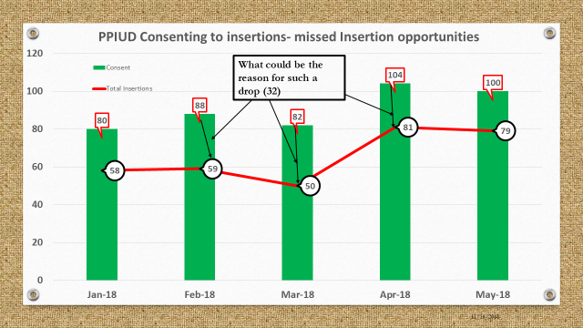
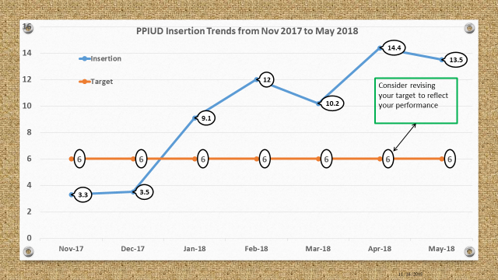
LARC in My own work.

Slide 21
What could be the reason for such a drop (32)

Slide 22

Thank You.
Asante-sana

